Slide 1
Cloud based Framework for Vehicle Overspeed Detection
Pratinav Mongia
Jainil Shah
Chaitanya Iyer

Slide 2
Problem Statement
According to the report ‘Saving millions of lives’, every year approximately 1.3 million persons worldwide lose their lives in traffic accidents each year, and another 20 to 50 million get injuries.
Road accidents are the greatest cause of death for people between the ages of 15 and 29. There is a lot of traffic in densely populated nations like India, making it challenging to monitor the speed of every car on the road
Both the driver and the general public are at danger when someone is driving too fast

Slide 3
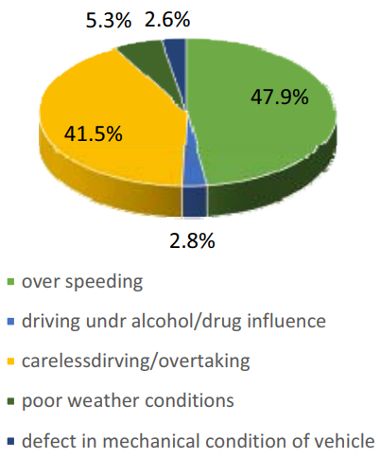
Statistics of Road Accidents in India during the last decade
Notes:
As can be seen from this figure, one of the primary causes of the rise in accidents today is excessive speed. Traffic accidents have been linked in large part to excessive speeding. High speed collisions cause crashes, serious injuries, and fatalities. According to WHO statistics, speed is thought to be the primary contributing factor in about half of all traffic accidents in some low- and middle-income nations, while it accounts for roughly 30% of traffic fatalities in high-income countries.

Slide 4
Adverse Effects of Speed
The amount of time a driver has to stop and avoid a collision decreases with increasing vehicle speed
The probability of a crash involving injuries normally increases by 3 percent for every 1 km/h increase in average speed, and it typically increases by 4-5 percent for crashes involving deaths
The severity of the impact when a collision does occur is also influenced by speed.

Slide 5
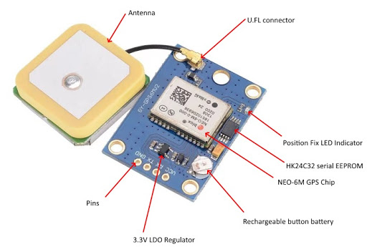
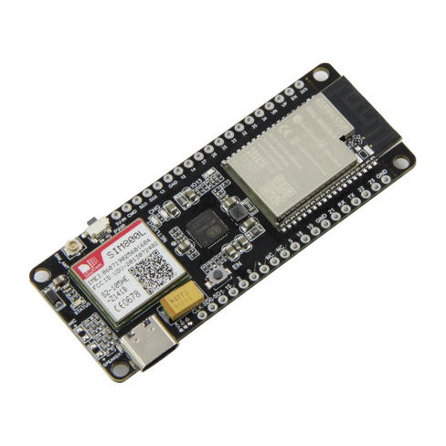
Hardware Used
GPS Neo-6M Module
Ttgo Sim 800L esp32 Module
Notes:
The module's brain is a GPS chip made by U-blox called the NEO-6M. The chip is less than the size of a postage stamp, but it contains a surprising number of features. It has a maximum tracking sensitivity of -161 dB and can monitor up to 22 satellites across 50 channels while using only 45 mA of current.
It can update its location five times in a second with a 2.5m horizontal position precision, which is faster than conventional GPS units. Additionally, the Time-To-First-Fix (TTFF) of the U-blox 6 positioning engine is less than one second.
Power Save Mode is one of the chip's best features (PSM). This enables a decrease in system power usage by selectively turning on and off specific receiver components. As a result, the module uses only 11mA, making it suitable for power-sensitive applications.
The TTGO T-Call is an ESP32 development board that combines a SIM800L GSM/GPRS module. The board includes SIMCom SIM800L GPRS module with ESP32 WiFi & Bluetooth WiSoC, and it relies on a USB-C connection for power and programming. It can also be a standalone board with a 500mA-capable built-in battery charger. Besides Wi-Fi and Bluetooth, one can communicate with this ESP32 board using SMS or phone calls and one can connect it to the internet using a SIM card data plan.

Slide 6
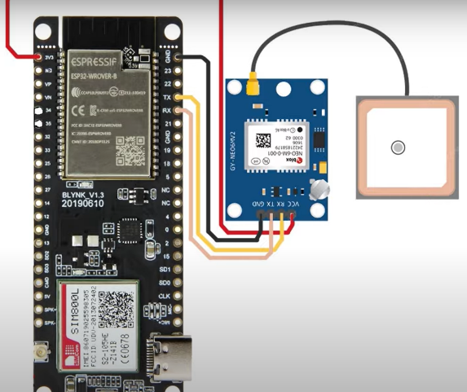
Setup
TTGO esp32 SIM800I Board
Internet
GPS Module and Power Source
Notes:
The TTGO esp32 SIM800l board will be connected to the gps module and the power source (through a type c cable). The TTGO board will be connected to the internet via a 2G sim.

Slide 7
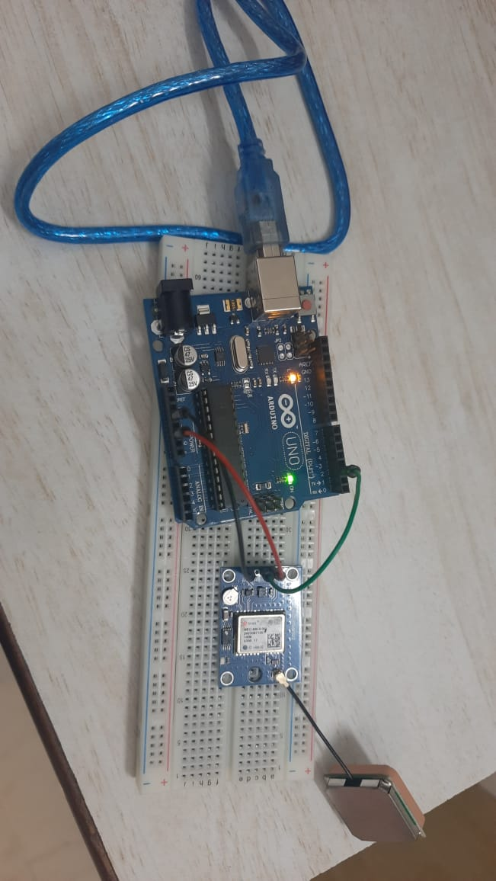
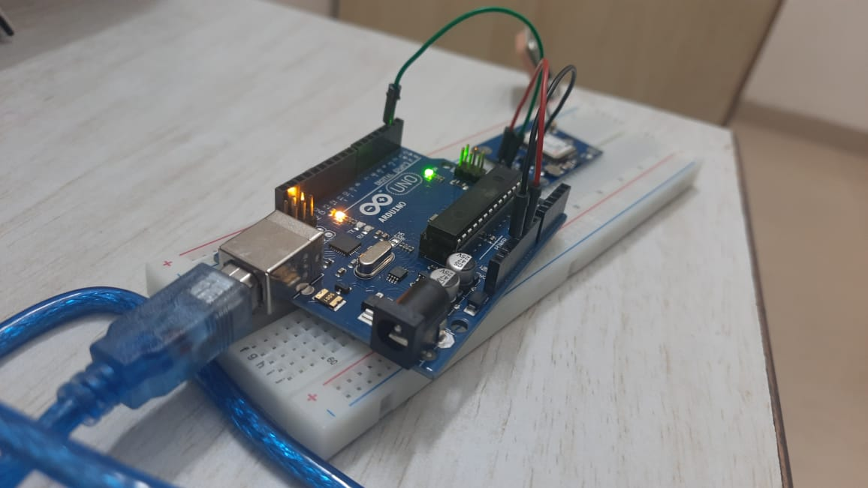
Our Hardware Framework

Slide 8
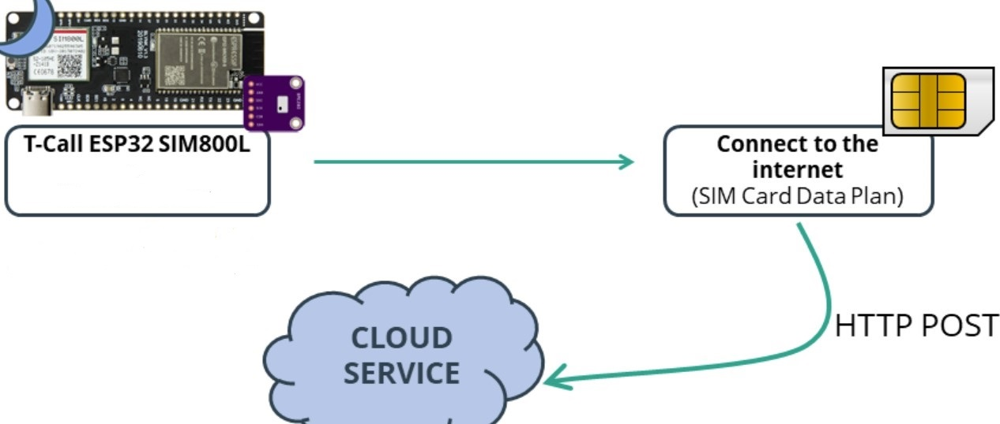
Working
Notes:
The SIM800L module will send the location and speed of the vehicle to the cloud. On the cloud side we will compare the speed sent by the module and speed limit of the road that the vehicle is traveling on. If the vehicle exceeds the speed limit the vehicle owner will be fined.
Moreover, depending on the location of the vehicle and the time we will also apply a congestion charge if necessary.

Slide 9
Execution of Python Code
GPS Reads Data
Arduino writes to CSV
Python Code Reads the CSV
Co-ordinates to decide street
Call to reverse geocoding API
Code extracts the co-ordinates and speed
Lookup of the street’s speed limit from database
Speed Comparison
Fine (if applicable)

Slide 10
Innovative Approach of the Proposed Solution to the Problem
Most of the existing systems for Vehicle Overspeed Detection make use of Infrared Radiation (in particular IR guns) which are placed only at certain specific locations on any particular road
Thus the driver tends to slow down and control his/her vehicle speed only at these known locations of placement of IR guns. This hampers the continuity of the Overspeed Detection process
Our solution makes use of GPS technology which makes continuous real-time monitoring of speed at almost every location all around the globe
A Cloud service is used to store data in our case as compared to a local database solution which has been used in majority of the current existing solutions

Slide 11
Limitations of this Project
The accuracy of the GPS sensor may cause issues in places such as junctions where two roads with different speed limits meet which can lead to false positives
Road accidents are the greatest cause of death for people between the ages of 15 and 29. There is a lot of traffic in densely populated nations like India, making it challenging to monitor the speed of every car on the road
Both the driver and the general public are at danger when someone is driving too fast
Notes:
To correct this we will be implementing a system that takes the margin of error into account (for first point in the slide)

Slide 12
Future Use Cases
The on board unit can also be used for other traffic violations and vehicle safety measures such as an drunk driving detection system using OpenCV and cameras recording facial expressions and eyes
Another potential use for the device would be as a part of a system to reduce vehicle congestion on roads
Notes:
This would be accomplished via real-time alerts to the driver taking into account their current position as well as the potential routes they may take and the traffic situation (for second point in the slide)

Slide 13
References
https://grobotronics.com/ttgo-t-call-esp32-with-sim800l-gprs-module.html?sl=en
https://randomnerdtutorials.com/esp32-sim800l-publish-data-to-cloud/
https://axleaddict.com/safety/Disadvantages-of-GPS
https://doi.org/10.1109/ic3i.2016.7918061
http://api.uofk.edu:8080/api/core/bitstreams/62fb70c3-802e-43dd-afd3-42d4af0a743a/content
https://doi.org/10.1155/2021/9888789

